Slide 1


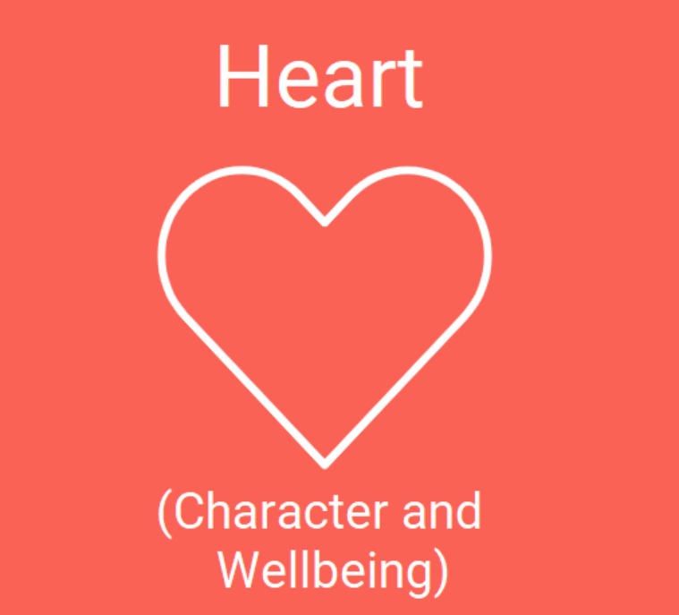

Year 4 multiplication tables check
Information for Parents
St Peter’s Junior School

Slide 2
What is it?
It is an online test for pupils in Year 4, which will be done in school in June. Pupils are asked to answer 25 questions on times tables from two to 12. They are given six seconds per question, with three seconds rest between each question, so the test should last less than five minutes.
Questions about the six, seven, eight, nine, and 12 times tables are likely to come up most often, as these are the hardest for most children to learn. It’s a good idea to focus on these tricky times tables with your child.
St Peter’s Junior School

Slide 3
What is it?
It is not a judgement on what your child can do, but a way for the school to know how their teaching is going and to adjust their focus if needed.
The check has been designed so that it is inclusive and accessible to as many children as possible, including those with special educational needs or disability (SEND) or English as an additional language (EAL). Access arrangements may need to be in place to support some individuals, your child’s teacher will consider this. There may be some circumstances in which it will not be appropriate for a pupil to take the check and again we will consider and discuss this.
St Peter’s Junior School

Slide 4
How can I help my child prepare?
In school we teach and practice multiplication tables regularly, in Year 3 this is often through memorable songs. In addition, we use things like counting sticks, recital and recall and online games to support.
The best way to keep the test stress-free is to work some times tables practice into your daily routine well in advance. With regular practice, your child will get used to tackling these kind of questions with confidence.
St Peter’s Junior School

Slide 5
5 Top Tips!
1. Use times table wall charts
Wall charts show all the answers for a particular times table. We have saved some of our website under ‘Head/Maths/Year 4 Multiplication Check’.
You could put them over the sink so that your child will see them when they’re brushing their teeth. You’ll be amazed how quickly they learn when they see these number facts every day!
St Peter’s Junior School

Slide 6
5 Top Tips!
2. Learn the tricks for difficult times tables
There are clever tricks for remembering several of the times tables, these are also available on our website.
Time Table Trick!
St Peter’s Junior School

Slide 7
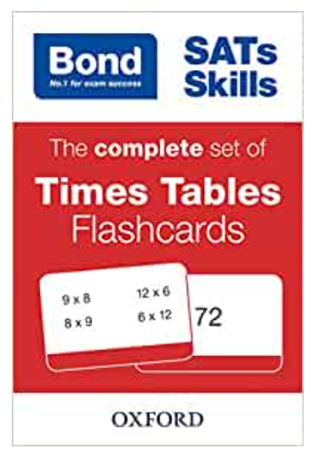
5 Top Tips!
3. Play times tables games
Games and challenges are a great way to support learning, and a few minutes a day will make all the difference. Why not play snap with some flashcards (Bond SATs Skills: The complete set of Times Tables Flashcards) available on Amazon.
Or you could surprise your child by asking times tables questions at random times during the day and seeing how quickly they can respond (this works particularly well as a competition between siblings or friends).
St Peter’s Junior School

Slide 8
5 Top Tips!
4. Make it real
If your child can’t see any point in learning their times tables, try showing them how this knowledge is useful in everyday life. Instead of just rote learning their times tables, try to create opportunities for your child to use multiplication in problem solving.
For example, ask them to scale up a recipe or calculate whether they have enough money to buy more of their favourite things (such as sweets or football cards). This will help your child see the value of their learning.
St Peter’s Junior School

Slide 9
5 Top Tips!
5. Practise on the computer
Help your child become comfortable reading and answering questions on a screen, especially against a clock or timer.
Use TT Rockstars to support and here are some other online multiplication games and resources to support:
You searched for times tables | Oxford Owl for Home
Times Tables Games for 7 to 11 year olds (topmarks.co.uk)
Times tables games - Timestables.co.uk
St Peter’s Junior School

Slide 10
You can find all this information and more on the school website:
Maths | St Peter's CofE Junior School (secure-primarysite.net)
St Peter’s Junior School

